Slide 1
EmpowHer
Session: AI

Slide 2
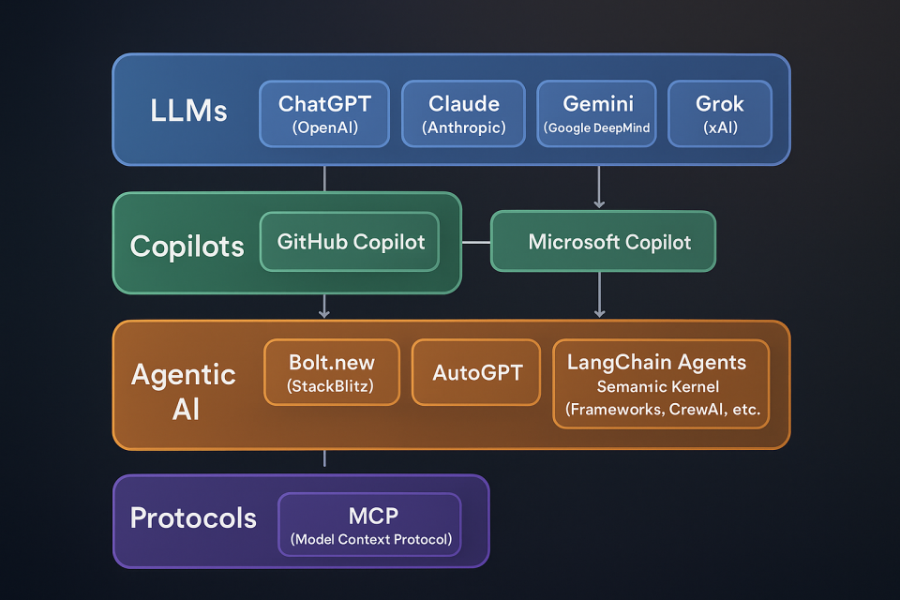

Slide 3
Agentic AI

Slide 4
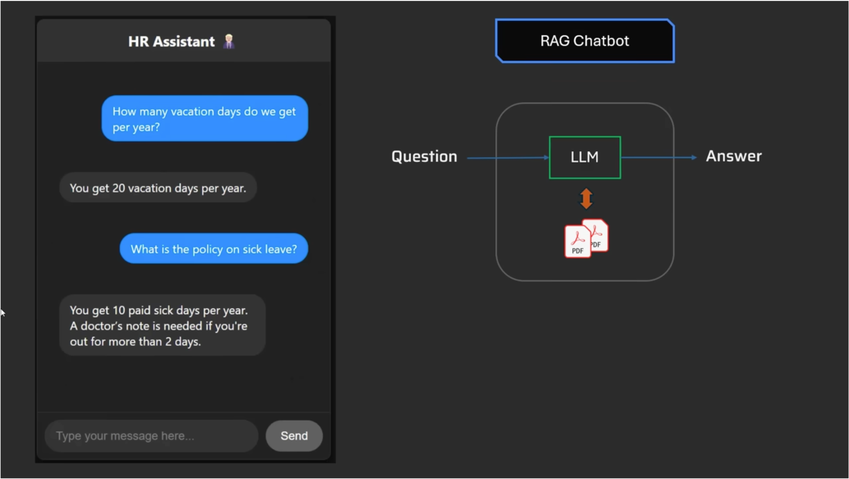
Rag Based
Workflow
Integration with Data source

Slide 5
Workflows vs Agents
Workflows differ from LLM agents, which are systems where the LLM dynamically directs its own processes and tool usage.
Workflows offer more control and predictability, while agents provide greater flexibility and adaptability.

Slide 6
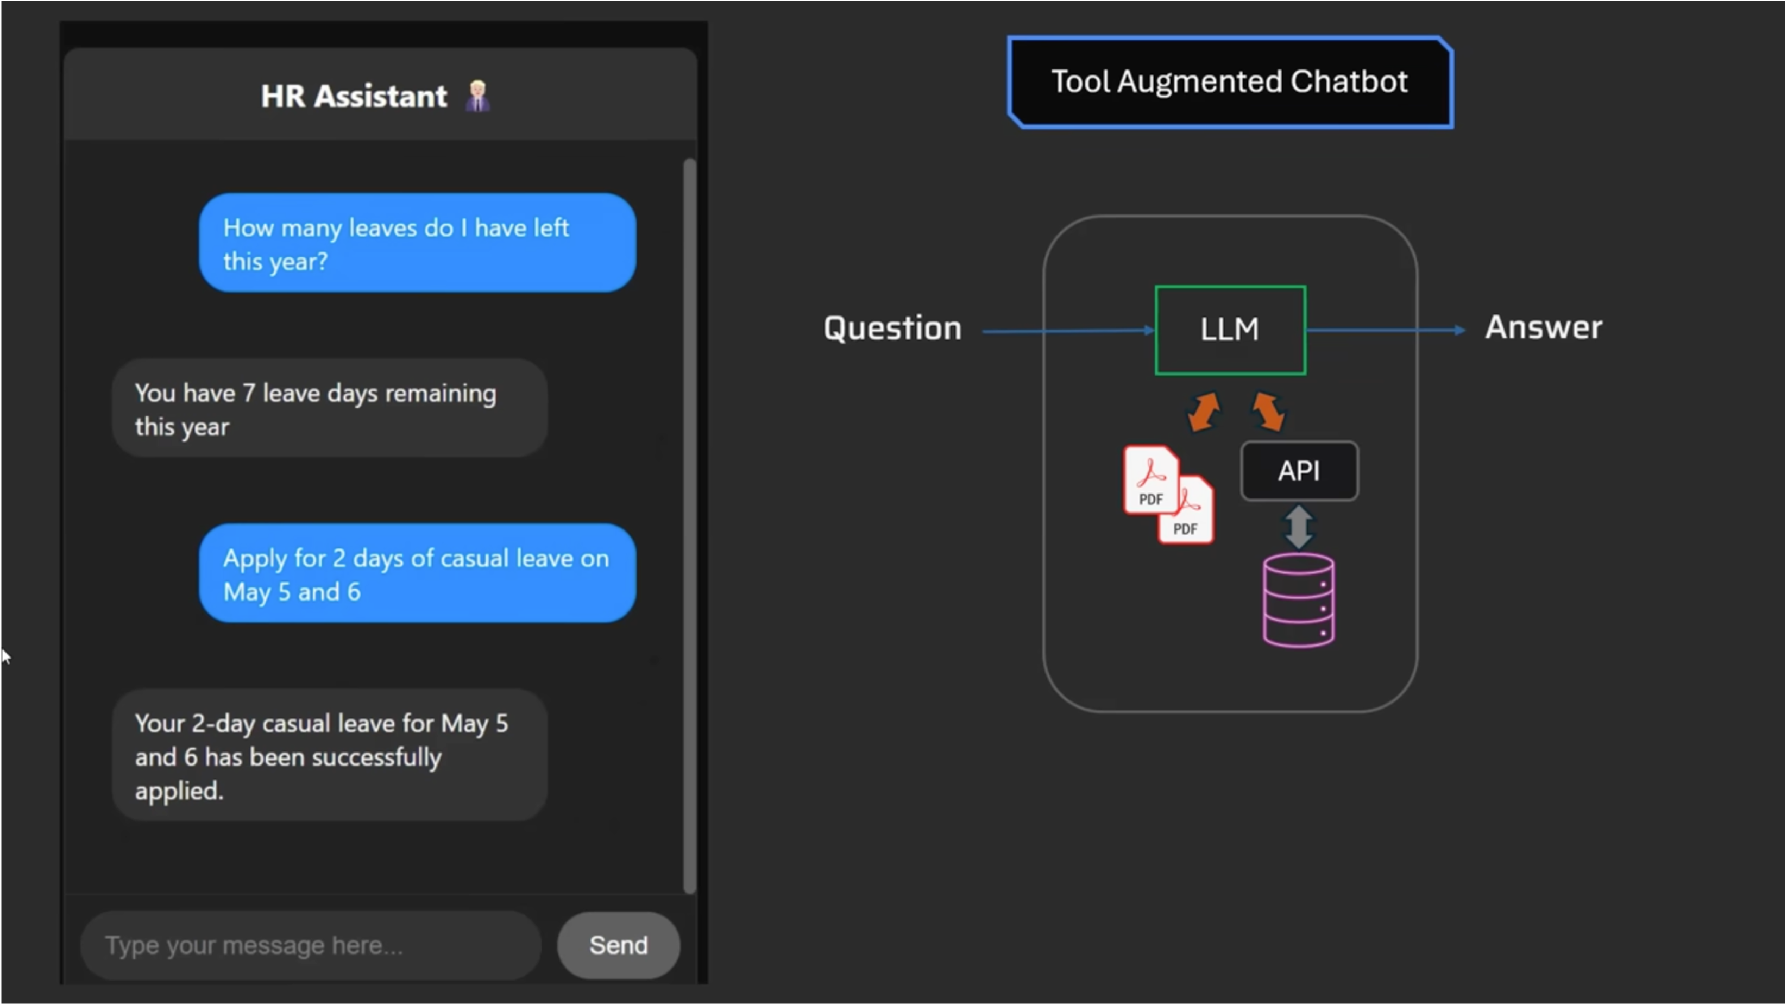
Tool Augmented Chatbot
Integration with other APIs
Communicate with API

Slide 7
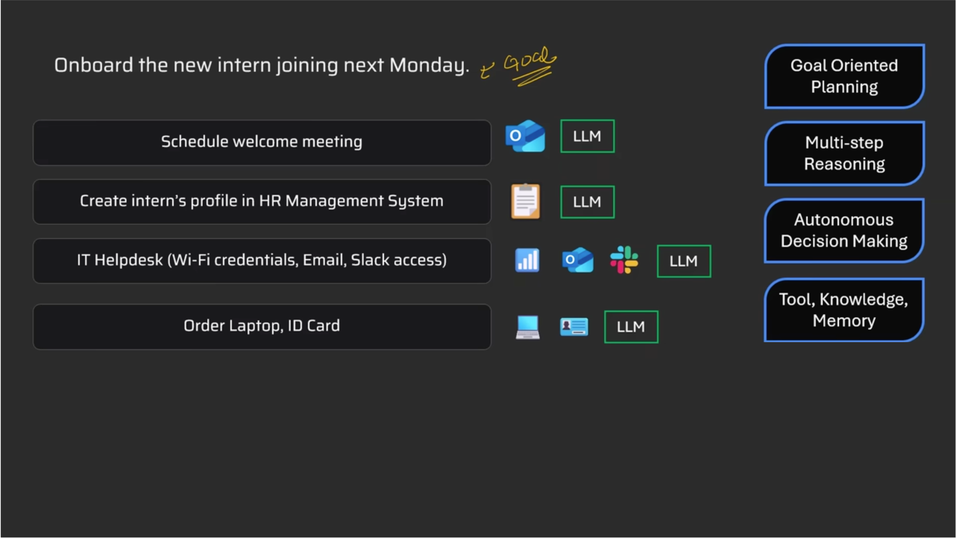
Agentic AI

Slide 8
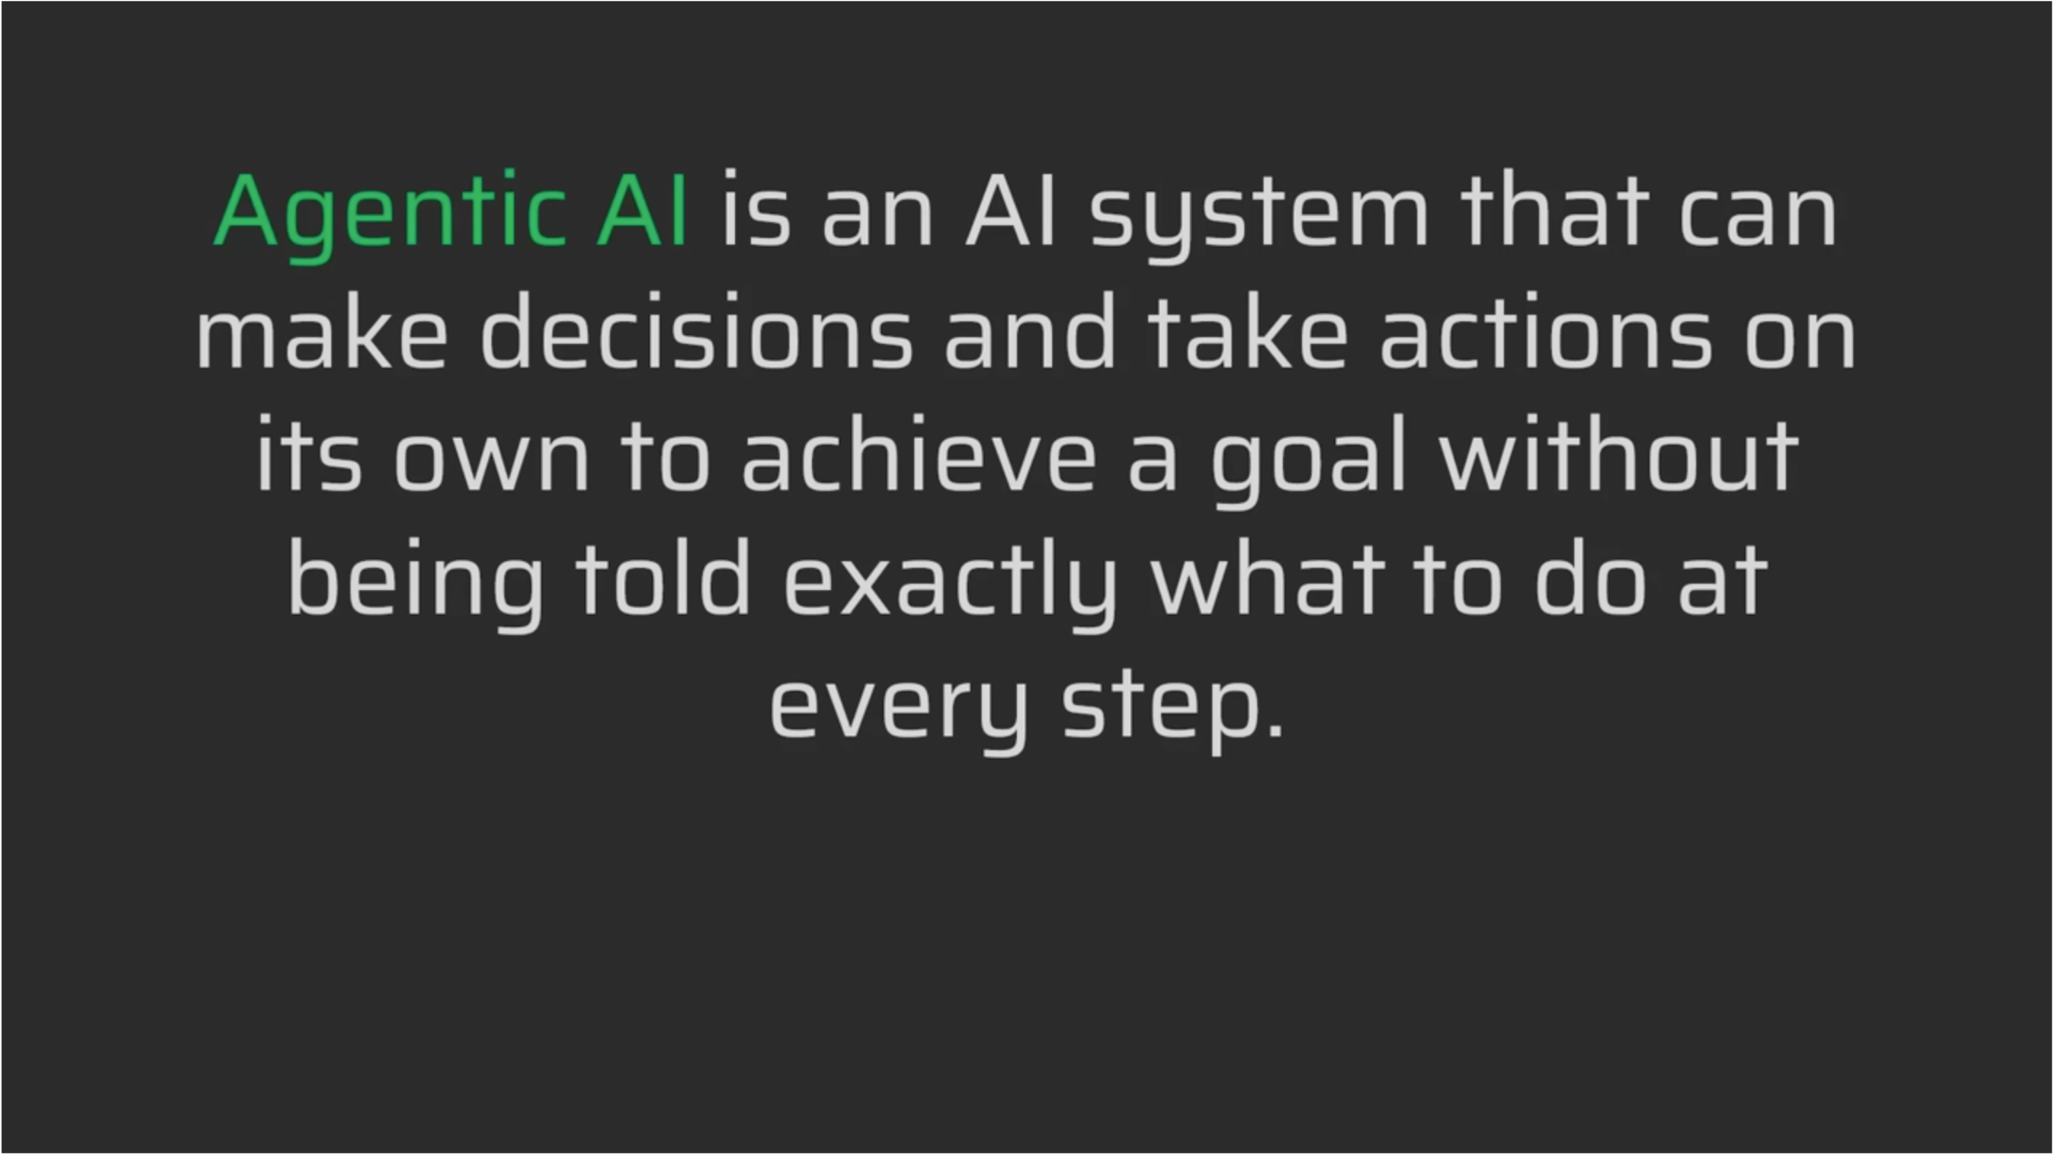

Slide 9
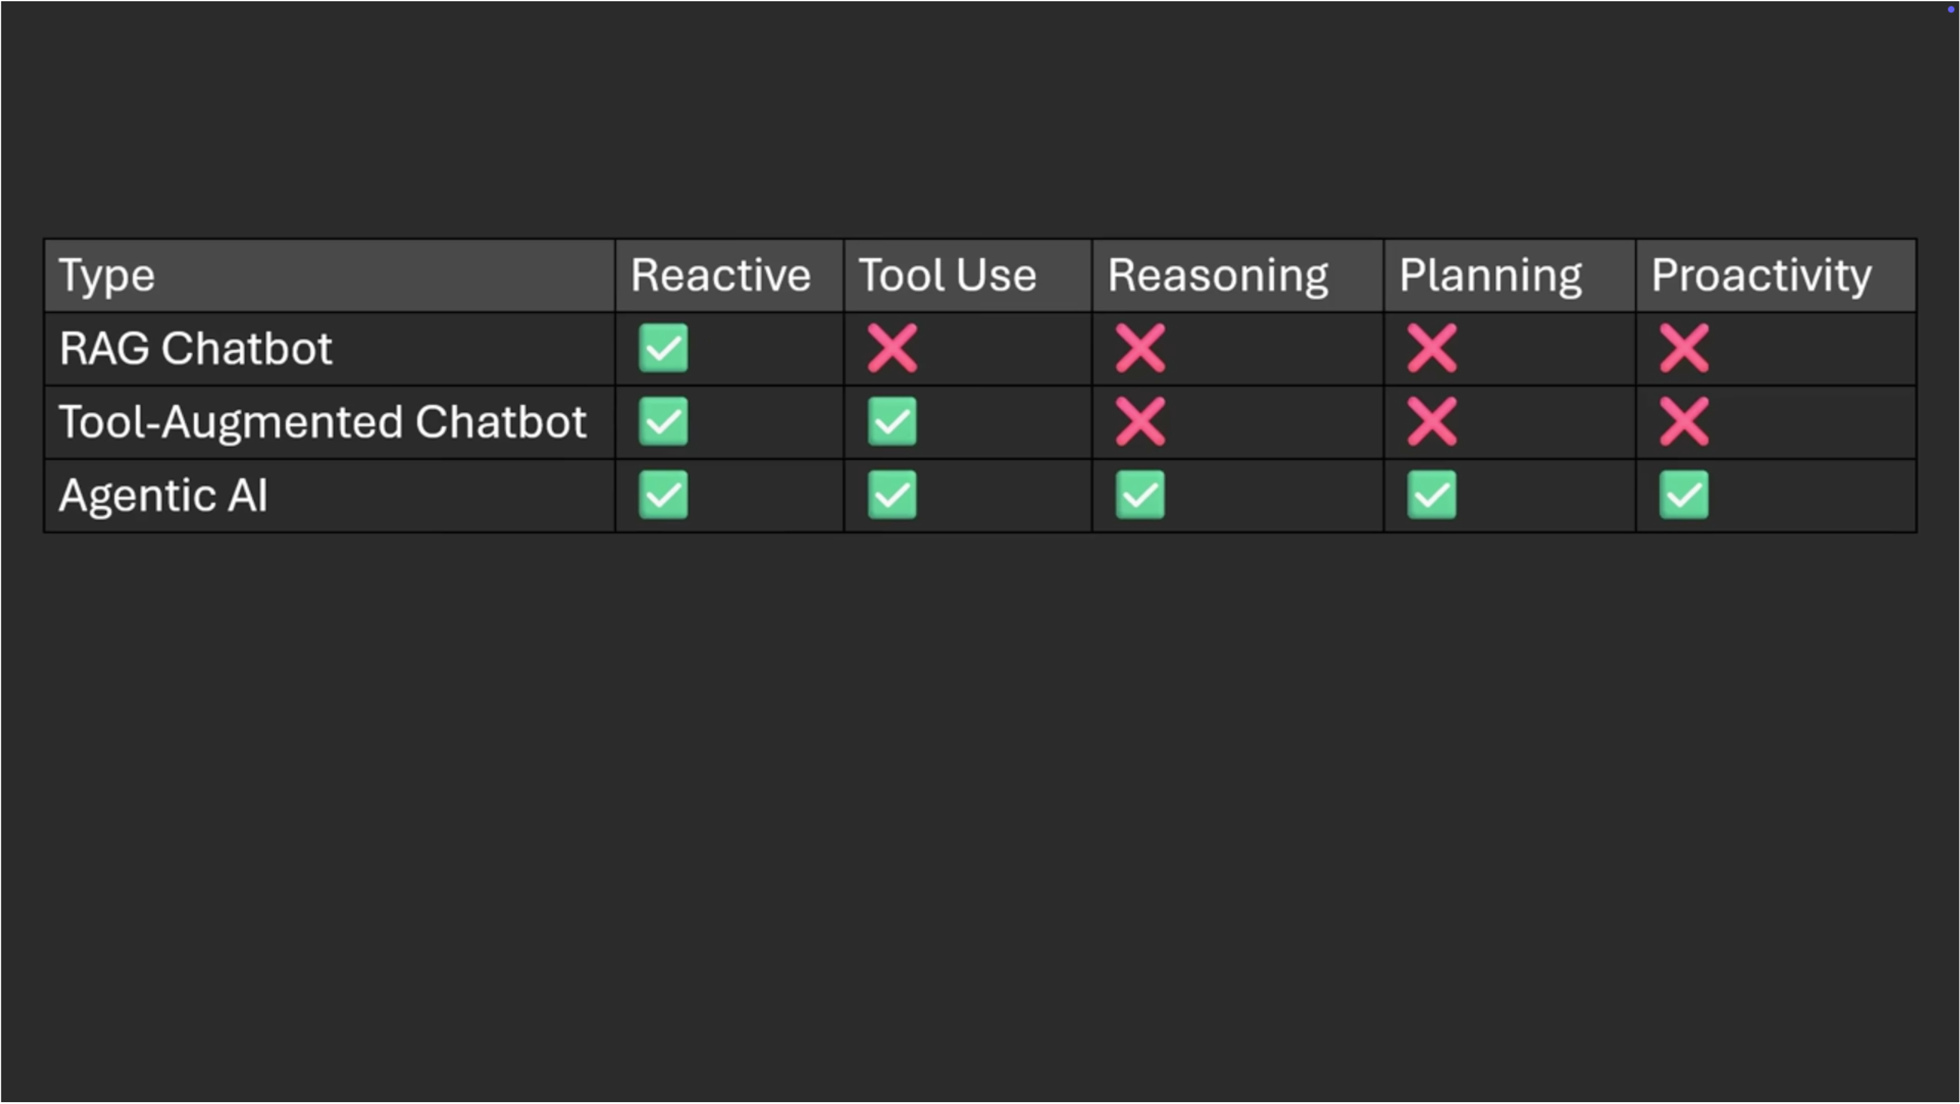

Slide 10
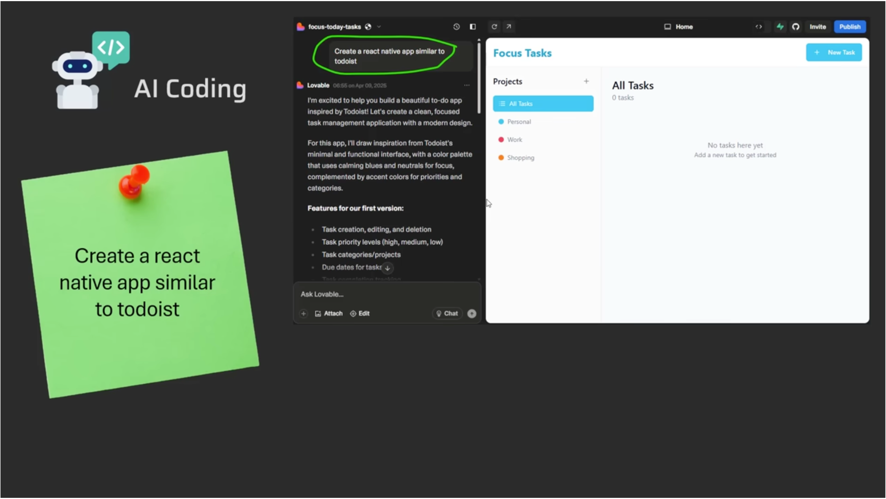

Slide 11
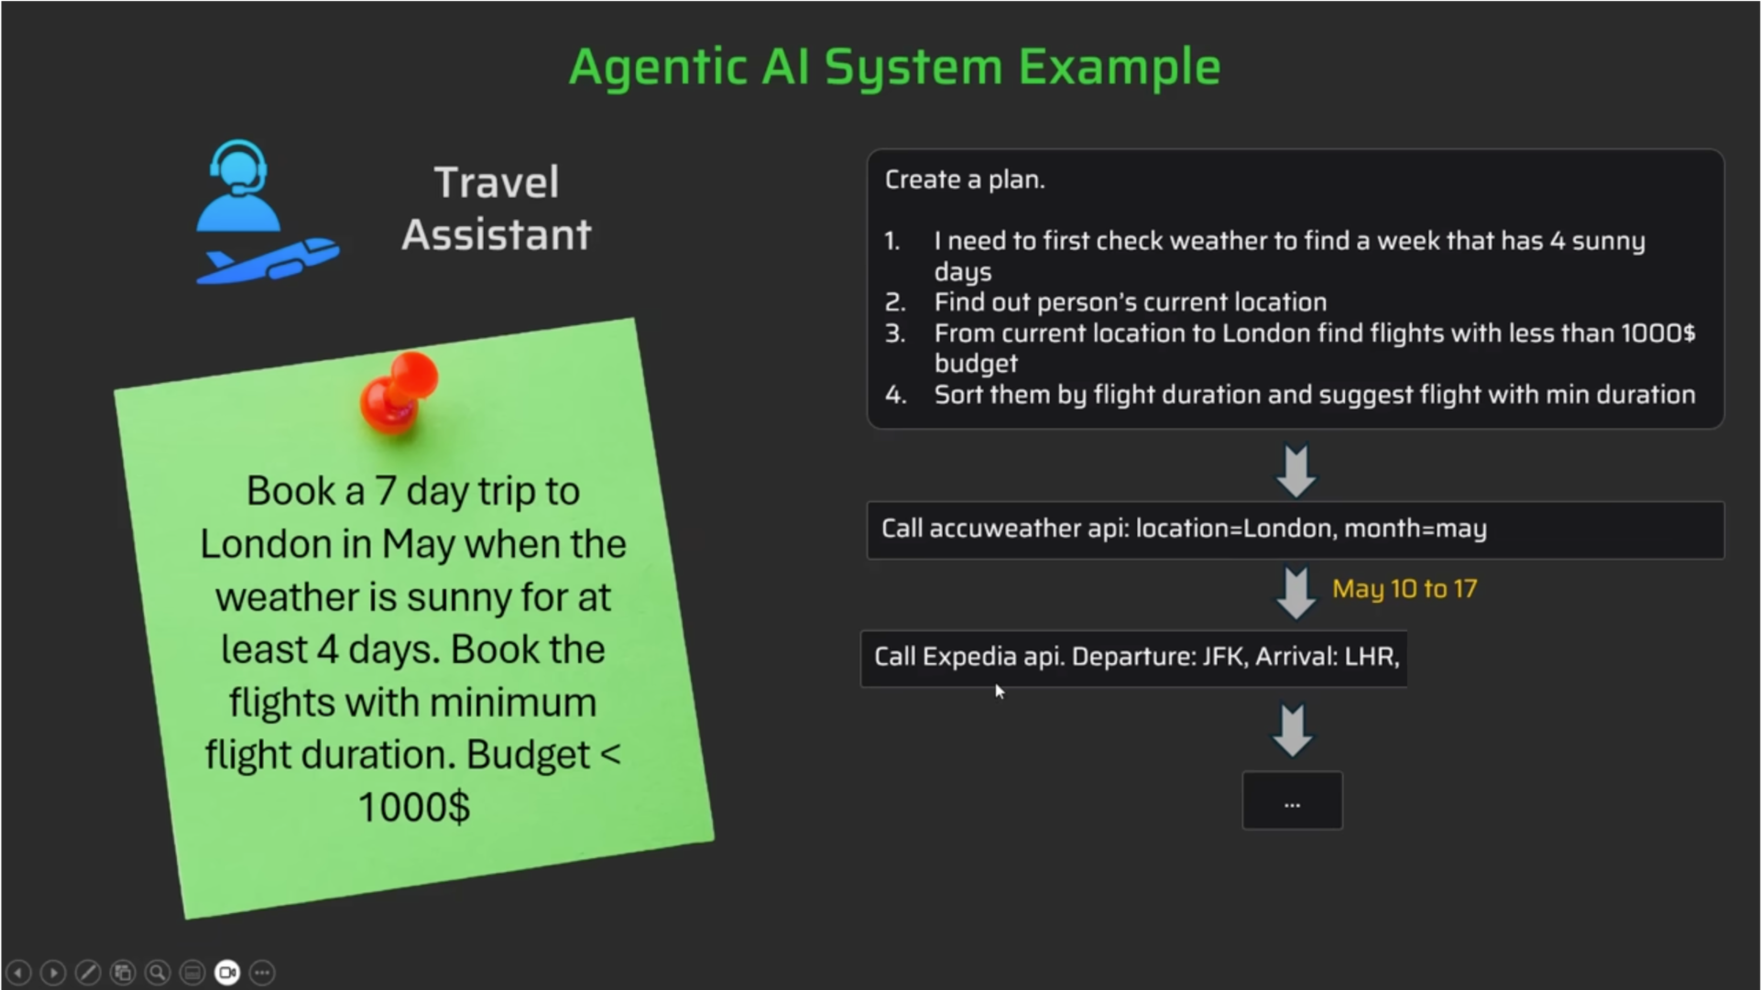

Slide 12
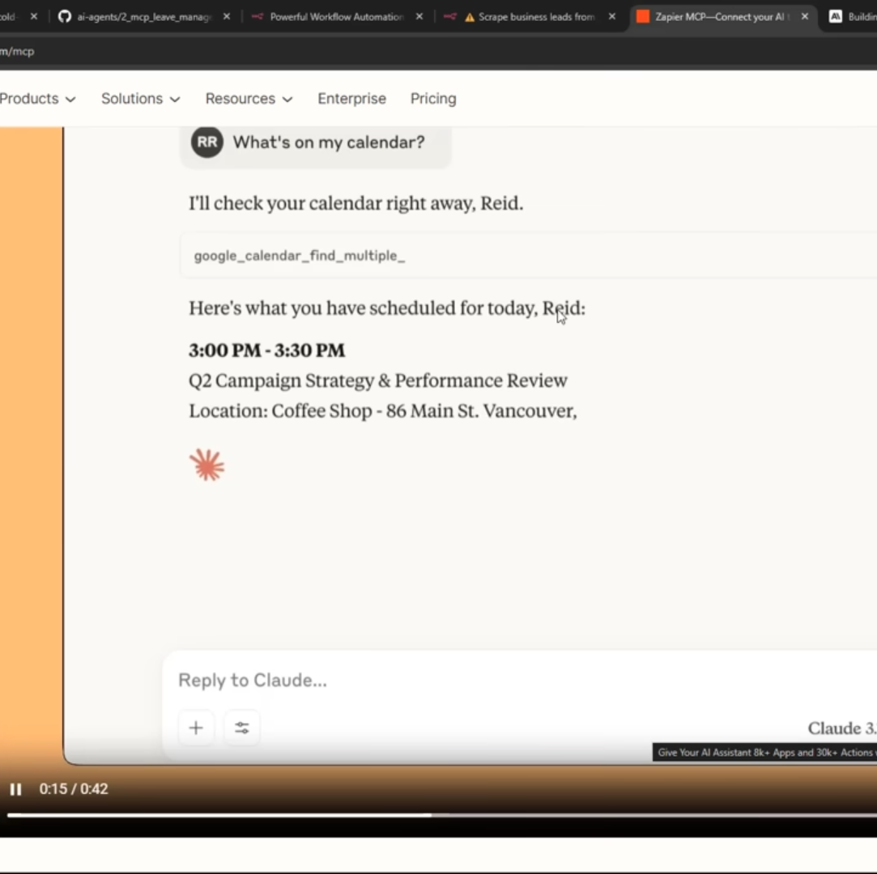
Low code examples
zapier

Slide 13
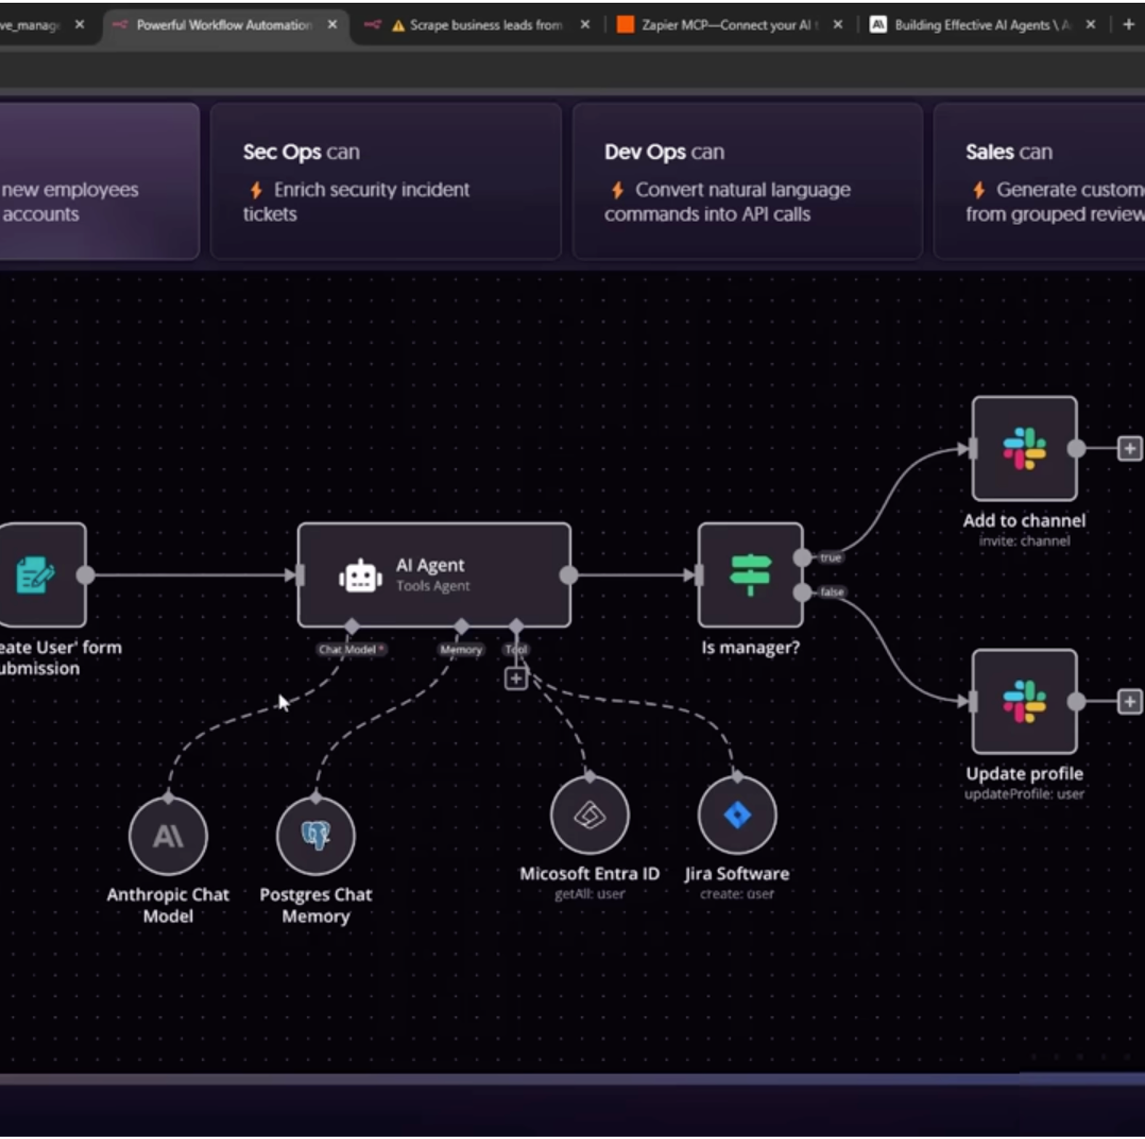
Low code Examples
n8n.io

Slide 14
Thank You!

